Slide 1
Unit2

Slide 2
Mid-Point Circle Drawing Algorithm
Given the centre point and radius of circle,
Mid Point Circle Drawing Algorithm attempts to generate the points of one octant.
The points for other octacts are generated using the eight symmetry property.

Slide 3
The mid-point circle drawing algorithm is an algorithm used to determine the points needed for rasterizing a circle.
We use the mid-point algorithm to calculate all the perimeter points of the circle in the first octant and then print them along with their mirror points in the other octants.
This will work because a circle is symmetric about it’s centre.

Slide 4
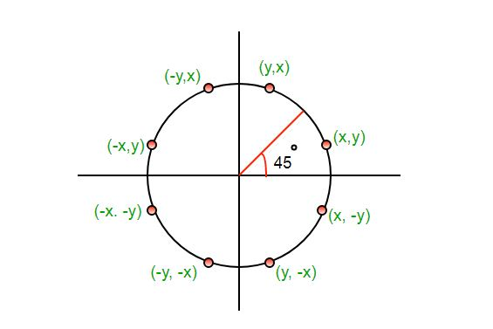

Slide 5
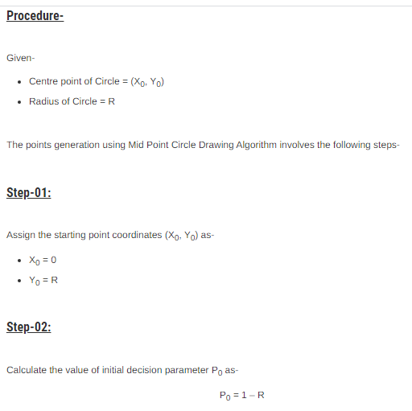

Slide 6
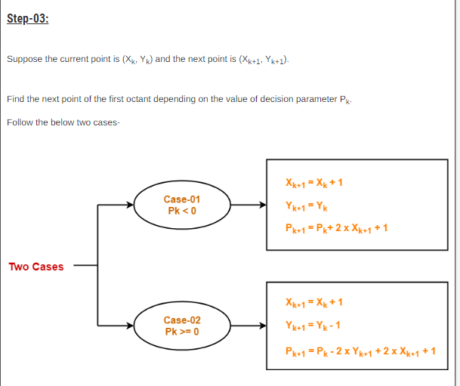

Slide 7
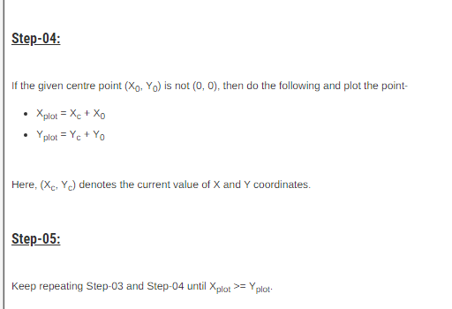

Slide 8
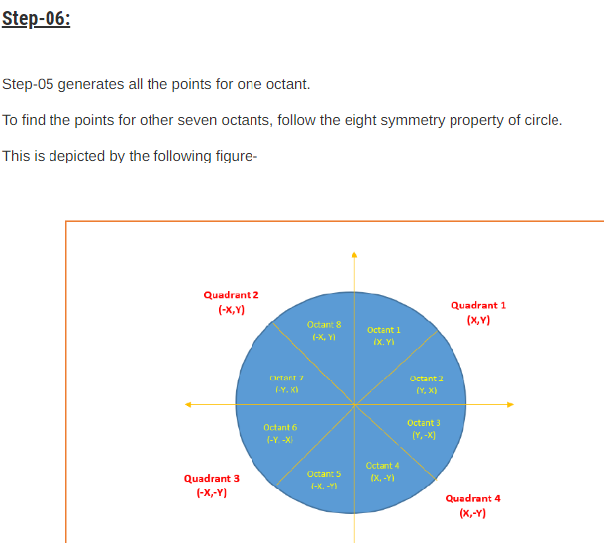

Slide 9
PRACTICE PROBLEMS BASED ON MID POINT CIRCLE DRAWING ALGORITHM-

Slide 10
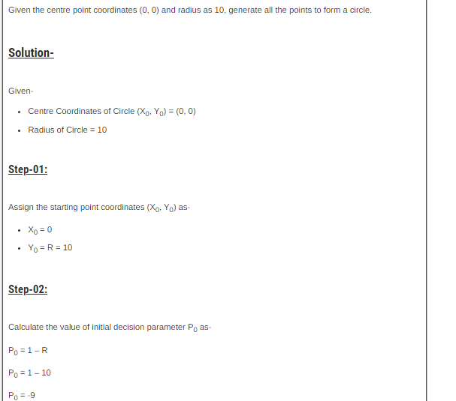
PROBLEM 01

Slide 11
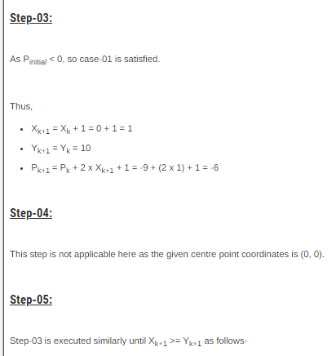

Slide 12
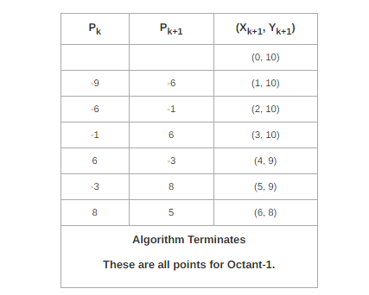

Slide 13
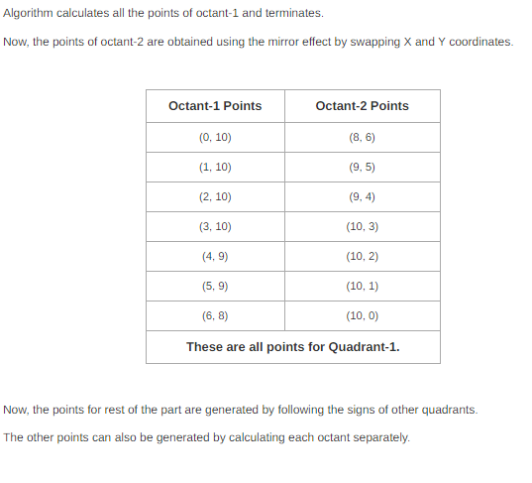

Slide 14
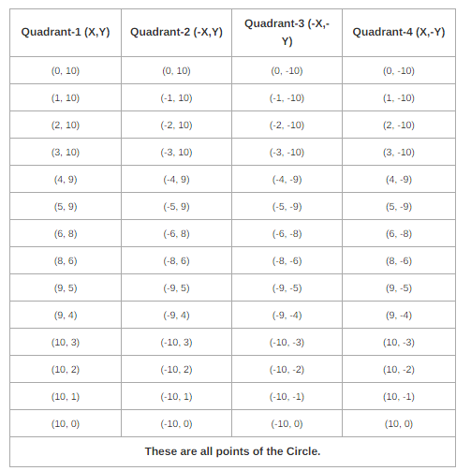

Slide 15
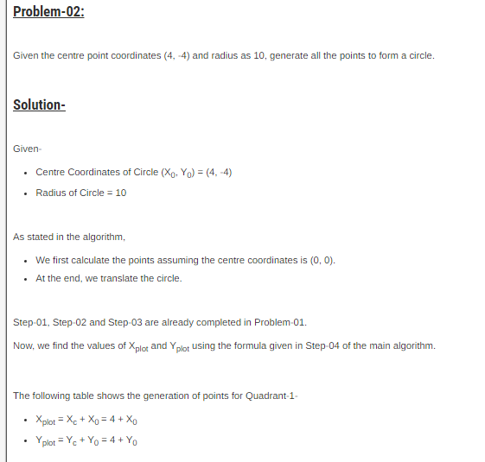

Slide 16
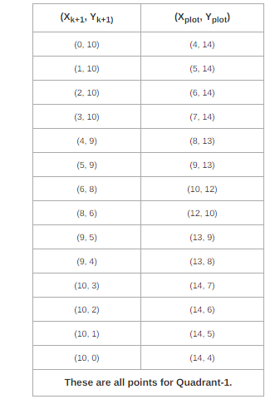

Slide 17
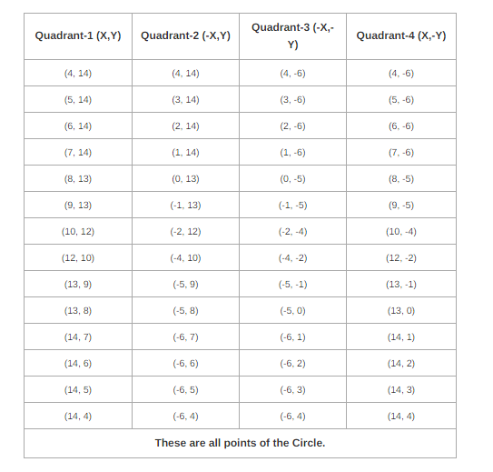

Slide 18
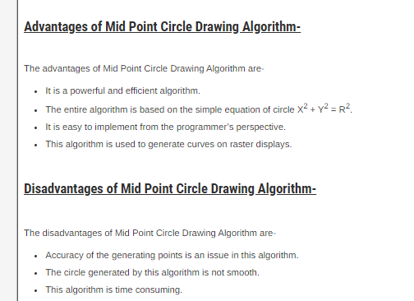

Slide 19
Examples for U

Slide 20
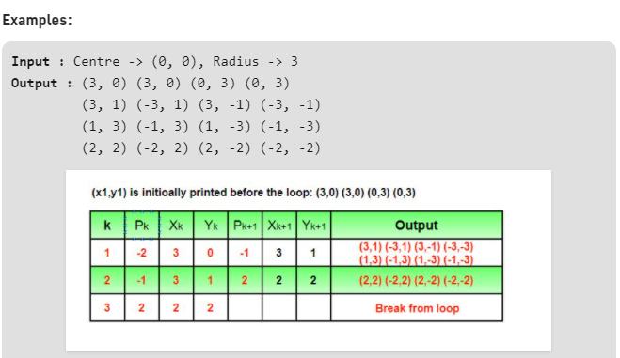

Slide 21
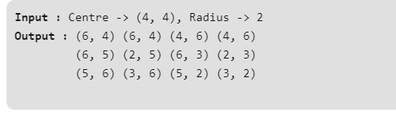
Example

